Slide 1

Bringing terminal experience to the new level
Krzysztof Dąbrowski
Full Stack Developer

Slide 2
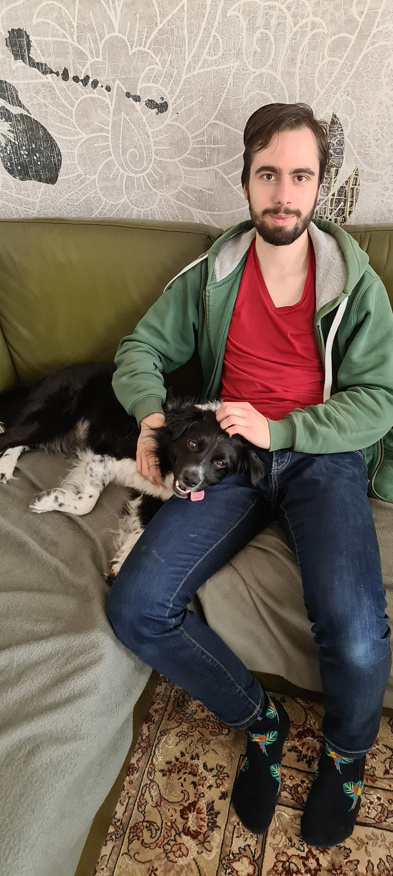
Few words about myself
Who is this guy?
Full Stack specialist in Perlica
Applied Computer Science graduate
Programming enthusiast full of excitement
I dive as deep as I can into the topics of my interest
Love to learn and spread the knowledge
Dog lover

Slide 3

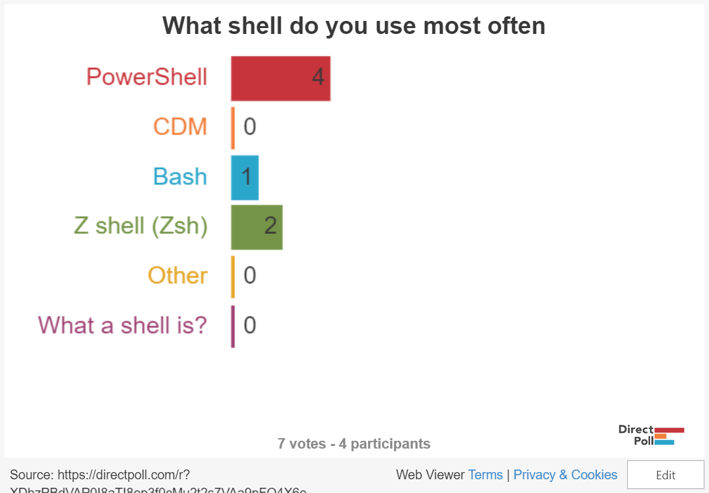
Your tool of choice
Let's get to know each other
http://etc.ch/DLN4

Slide 4
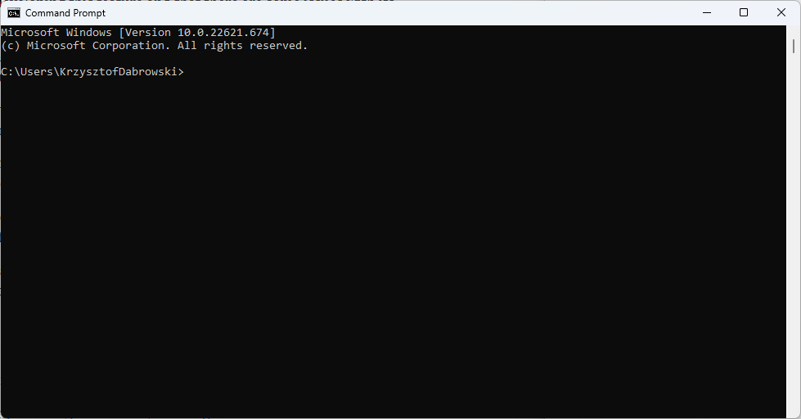
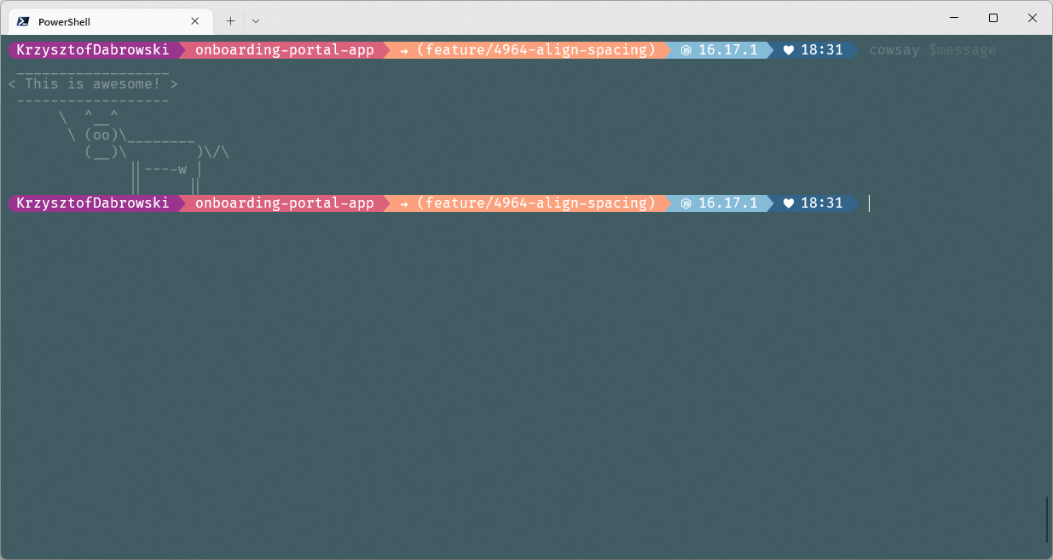
The journey
The journey of a thousand miles begins with one step
The beginning
After today :D

Slide 5
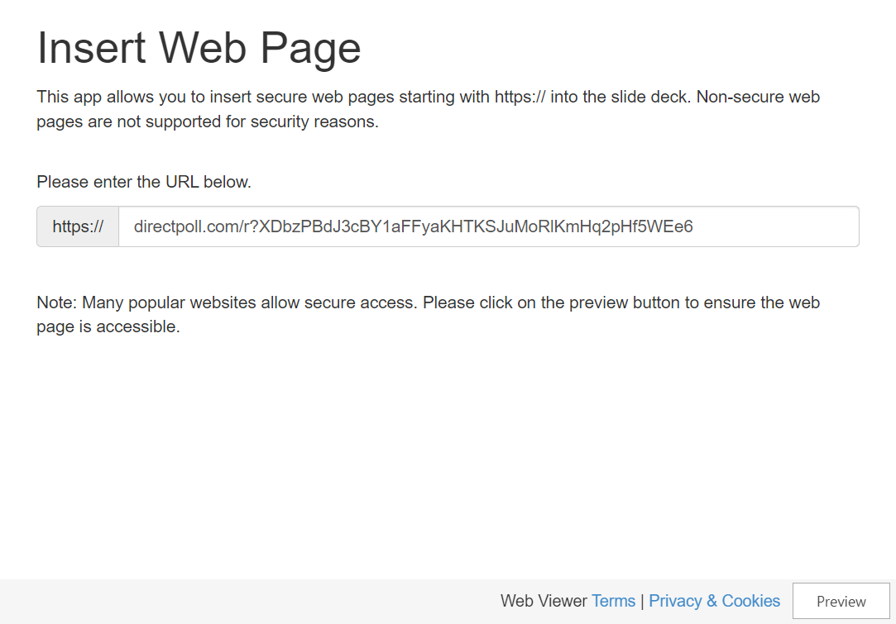
What’s your experience?
Have you done something like this before?
http://etc.ch/DLN4

Slide 6
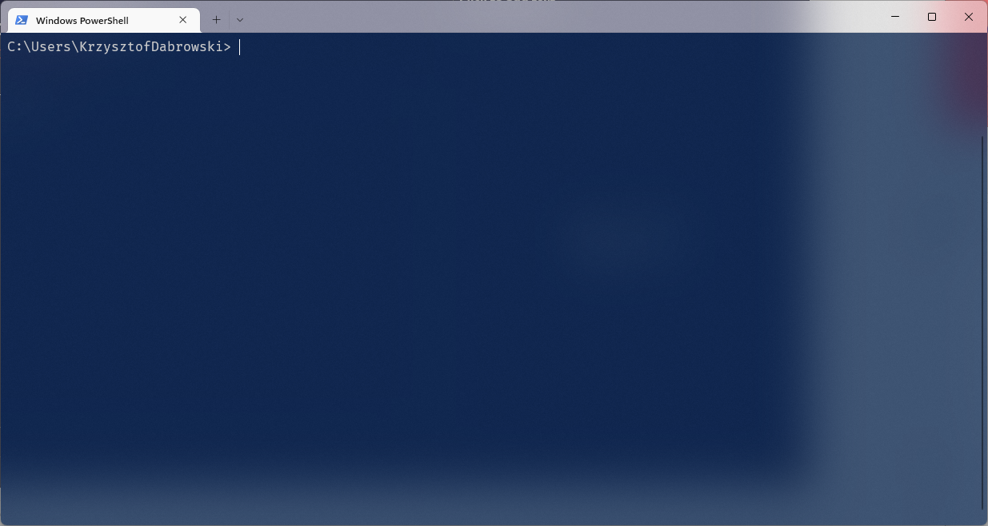
First improvement
#1 Windows Terminal
Default option on Windows 11
Modern look
Somewhat customizable
Notes:
- Check how to set it as default in Windows 10
- Download link

Slide 7

Follow along guide
Let’s make your terminals pretty! 🥳
shorturl.at/lQY04

Slide 8
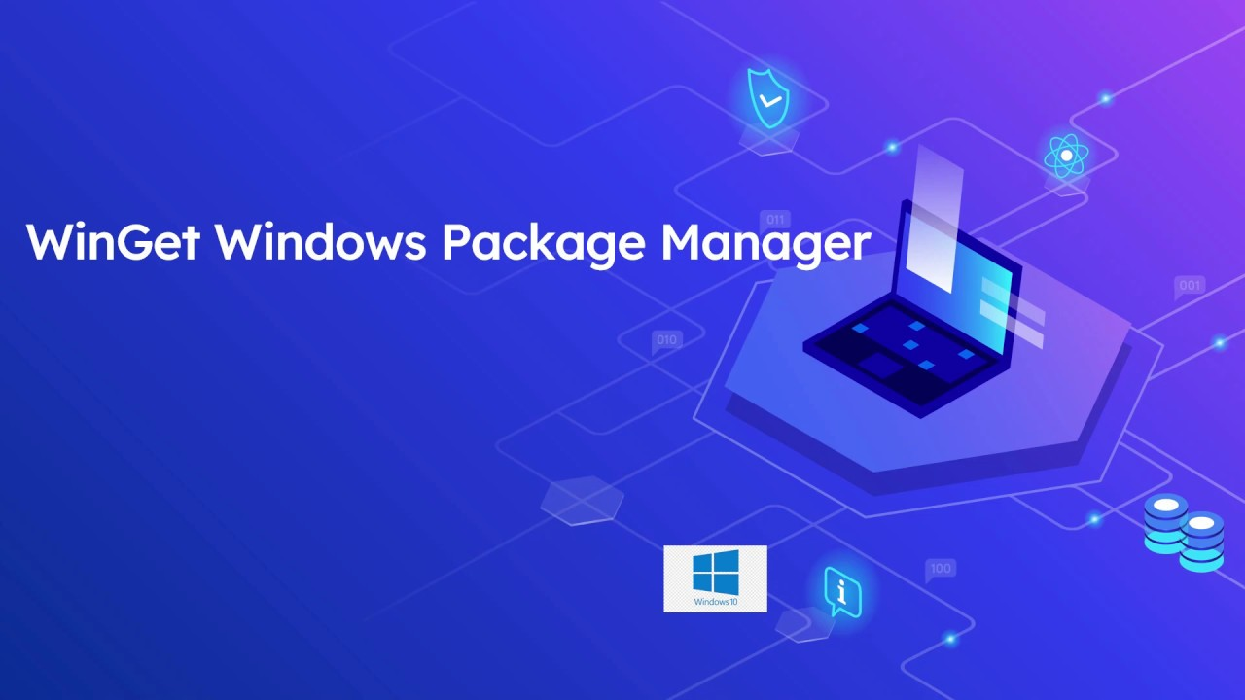
Installing apps with terminal
#2 I don’t want to go back
Install programs with a simple command
No need to search for the right installer
Update all apps with one command
Export your config
winget install
winget upgrade --all

Slide 9

PowerShell Profile
Run commands on every shell start
Content of file pointed by $PROFILE is run at the start of every session
That’s the place some of our customizations needs to go!

Slide 10
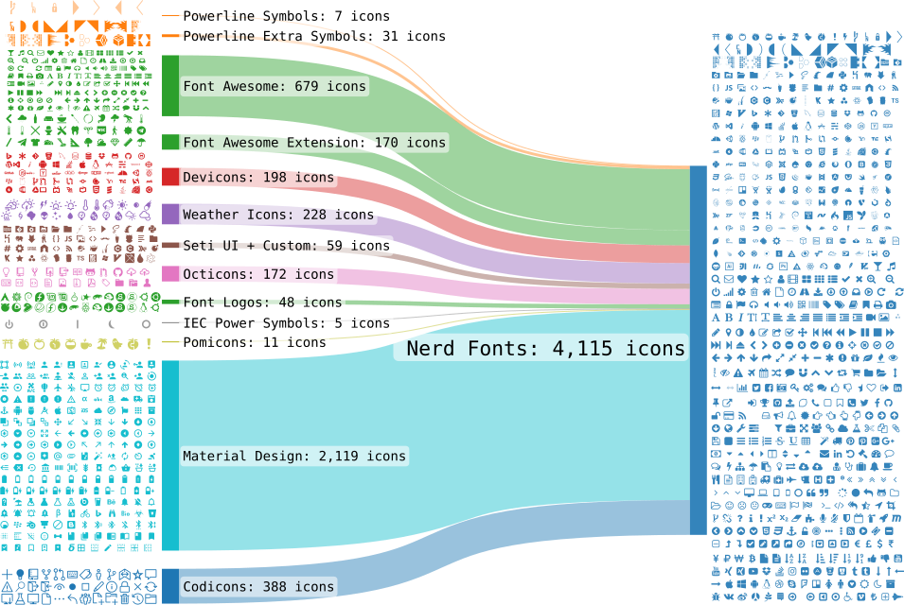
Font with Powerline symbols
4. All symbols included

Slide 11
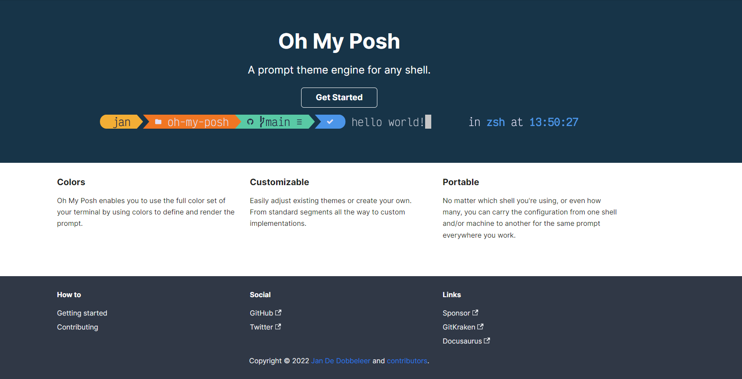
Oh My Posh
5. The main course!

Slide 12
Thank you for attending!

